Slide 1
Secure Routing in Wireless Sensor Networks : Attacks and Countermeasures

Slide 2
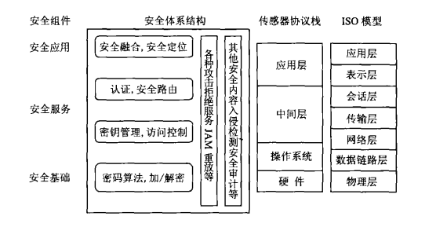
WSN安全体系结构

Slide 3
安全路由
在WSN所有的安全问题中,路由的安全最为重要
一个WSN节点不仅是一个主机,而且是一个路由器
WSN路由协议的首要任务是在一对节点中建立正确、有效的路由,实时地发送消息。如果路由被误导,整个网络可能陷于瘫痪。
路由安全在整个WSN安全中扮演了一个重要的角色

Slide 4
Two types of threat models
路由信息可能遭到多种形式的攻击,这些攻击主要分为两类,即被动攻击和主动攻击。
被动攻击指攻击者仅监听路由信息而不破坏路由协议的执行过程;
主动攻击又分为内部攻击和外部攻击。指攻击者阻止路由的建立、更改数据的传送方向、中断路由以及利用虚假数据骗取等。

Slide 5
Problem Statement cont’d
Based on type of attacking devices
  Mote-class attackers： access to few sensor nodes（微型攻击者）
  Laptop-class attackers ： Access to more powerful devices. Have more battery power, better CPU, sensitive antenna, powerful radio Tx, etc

Slide 6
Problem Statement contd.
Based on attacker type / attacker location
  Outside attacks → attacker external to the network
  Inside attacks → Authorized node in the network is malicious/compromised

Slide 7
Attacks
Two Categories :
  Attacks on general sensor network routing
  Attacks on specific sensor network protocols

Slide 8
Security goals
  Confidentiality, integrity, authenticity, and availability of all messages

Slide 9
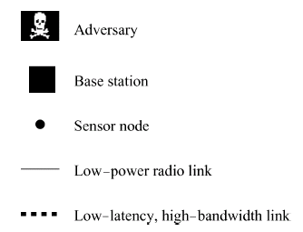
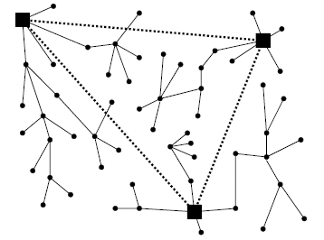
Background
A representative sensor network architecture
Picture from [7]

Slide 10
Attacks on General Routing
By Spoofing, Altering, or Replaying routing information → Attacker can create loops, attract or repel network traffic, generate false message, partition network, induce delay, etc
Selective forwarding → Malicious node forwards only some messages, drop others. Attacker tries to be on the actual path of data flow

Slide 11
Sinkhole Attacks →
  Main Reason : Specialized communication patterns supported by wsn ; All packets have same destination i.e. base station
  Adversary tries to attract traffic from a particular area to pass through a compromised node, thereby creating sinkhole with adversary at the center
  A node may be made to look attractive to neighbors in some routing algorithm
  Laptop class adversary provide a high quality route to base station by transmitting at high power OR creating a wormhole
  Can enable other attacks e.g. selective forwarding

Slide 12
Attacks on sensor network routing cont’d
HELLO flood attack
  Many protocols require that nodes broadcast HELLO packets to announce themselves to their neighbors
  Laptop-class attacker can convince all nodes that it is their neighbor by transmitting at high power
Acknowledgement spoofing
  Some routing algorithms require explicit/implicit link layer ACKs
  Adversary can spoof ACKs for control packets and try to convince the sender that a weak link is strong or a dead link is alive; causing packet losses

Slide 13
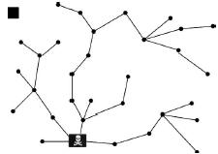
Attacks on specific sensor network protocols
TinyOS beaconing
  Description
  Attacks
Can authenticated routing updates solve the problem?
Tiny OS是UC Berkeley（加州大学伯克利分校）开发的开放源代码操作系统，专为嵌入式无线传感网络设计，操作系统基于构件（component-based）的架构使得快速的更新成为可能，而这又减小了受传感网络存储器限制的代码长度。
Picture from [7]

Slide 14
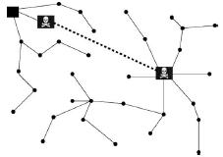
Attacks on specific sensor network protocols cont’d
Combined wormhole/sinkhole attack
Picture from [7]

Slide 15
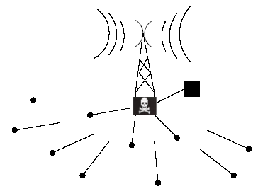
Attacks on specific sensor network protocols cont’d
What if a laptop-class adversary uses a HELLO flood attack?
What about mote-class adversaries?
  Routing loops
Picture from [7]

Slide 16
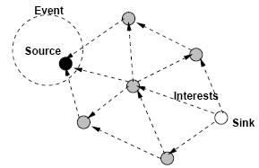
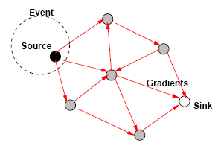
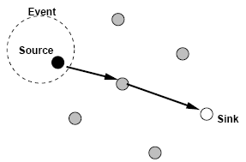
Attacks on specific sensor network protocols cont’d
Directed diffusion
Interest propagation
Initial gradients set up
Data delivery along reinforced path
  Attacks :– 1.Cloning克隆i.e. Replay of interest by the adversary
  2.Selective forwarding 3. data tampering篡改
Pictures from [6]
Notes:
An interest is injected into the network at some node – sink in this case. The sink periodically broadcasts an interest message to all of its neighbors This dissemination sets up gradients within the network designed to draw events, i.e data matching the interest.
Every node maintains an interest cache. When a node receives an interest, it checks to see if the interest exists in the cache. If no matching entry exists, the node creates an interest entry. The interest entry has a single gradient toward the neighbor from which the interest was received. This gradient has a duration and event data rate. After receiving an interest, a node may decide to re-send the interest to some subset of its neighbors. To its neighbors, this interest appears to originate from the sending node, although it might have come from a distinct sink. When a gradient expires, it is removed from its interest entry.
A node that receives a data message from its neighbors attempts to find a matching interest entry in its cache. If no match exists, the data message is dropped. If a match exists, the node checks the data cache for a duplicate entry. If no matching data cache entry exists, the received message is added to the data cache and the data message is resent to the node’s neighbors.
Once sources detect a matching target, they send low-rate events along multiple paths toward the sink. After the sink receives these low data rate events, it reinforces one particular neighbor in order to draw down higher quality (data rate) events.

Slide 17
Attacks on specific sensor network protocols
Geographic routing
  Two protocols
    GPSR (Greedy Perimeter Stateless Routing)
    GEAR (Geographic and Energy Aware Routing)
  Description
    Greedy forwarding routing each packet to the neighbor closest to the destination
    GEAR weighs the choice of the next hop by both remaining energy and distance from the target

Slide 18
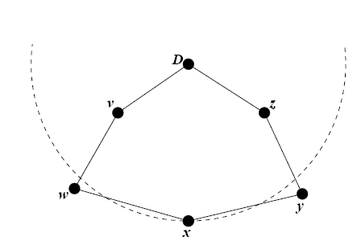
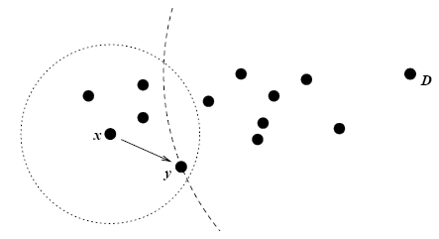
Attacks on specific sensor network protocols cont’d
Geographic routing
Greedy forwarding failure: x is a local maximum in
its geographic proximity to D; w and y are farther from D.
Greedy forwarding example: y is x’s closest neighbor to D
Pictures from [14]

Slide 19
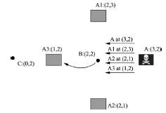
Attacks on specific sensor network protocols cont’d
Geographic routing
1. Sybil attack Attack
  Adversary advertise wrong location info. so as to place himself in the path

Slide 20
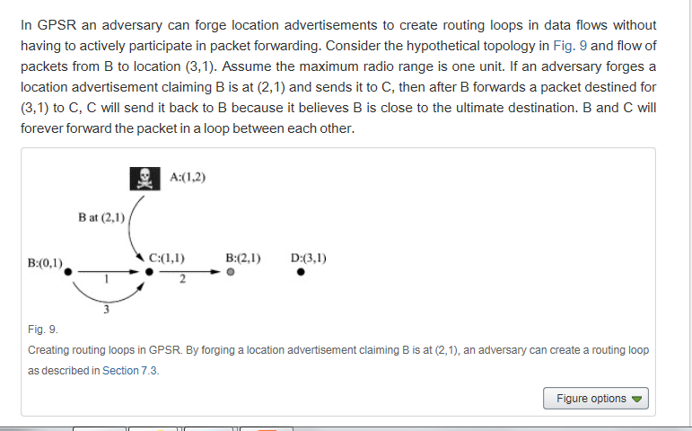
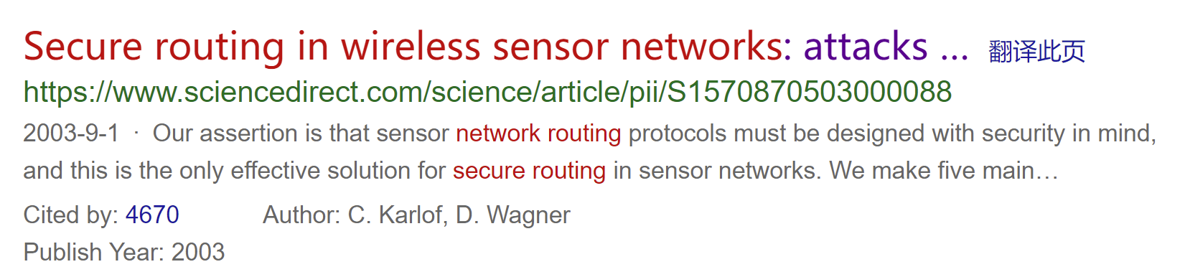
Adversary forge location advertisements creating routing loops

Slide 21
Attacks on specific sensor network protocols cont’d
LEACH: low-energy adaptive clustering hierarchy
  Description
    Nodes organized into clusters with one node serving as a cluster-head
    Cluster-heads aggregate data for transmission to a base station
  Attacks
    HELLO flood attack
    Countermeasures defeated by a Sybil attack

Slide 22
Attack 总结
（1）虚假路由信息
通过欺骗、篡改和重发路由信息，攻击者可以创建路由环吸引或者拒绝网络信息流通量，延长或者缩短路由路经，形成虚假错误消息，以分割网络增加端到端的时延。
（2）选择性地转发
节点收到数据包后有选择地转发或者根本不转发收到的数据包，导致数据包不能达到目的地
攻击者最可能攻击的路径是抵抗力最弱的路径，并且企图
把自己藏身于数据流传输的实际路径之上。

Slide 23
（3）槽洞(Sinkhole)攻击
敌人通过创造一个特别算法的恶意节点，尽可能地引诱其他节点通过它传递数据信息。当数据信息经过该节点时，恶意节点就可以并用其他的攻击方法改写或者丢弃数据信息包。
（4）女巫(Sybil)攻击
在女巫攻击中，恶意节点通过特殊算法扮演多种不同的角色，使之具有成为其他节点的下一跳路由，为选择转发攻击提供了方便，并且可以随意更换自己的坐标信息。这种攻击方法对分布式存储路由、分散路由和多路径路由等的威胁很大，并对地理路由也是重大威胁

Slide 24
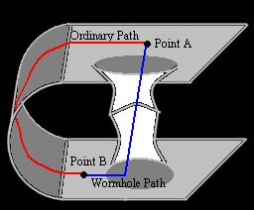
（5）蠕洞(Wormhole)攻击
蠕洞攻击的常见形式是两个相距很远的恶意节点通过捏造、伪装、虚报两者之问的距离，使得其他节点误以为它们之间只需要一两跳就可以到达基站，把大量的数据信息通过它们进行传输。蠕洞攻击可以与选择转发或者女巫攻击联合使用，对WSN的安全威胁很大。

Slide 25
（6）问候泛洪(HelioFlooding)攻击
恶意节点发出足够功率的广播包(路由或者其他信息)，使得网络中的每个节点都误以为恶意节点是自己的邻居。从而有大量的数据包发送给恶意节点，事实上，恶意节点和发送节点相距甚远，它们发送的大量包都被丢弃了。
（7）伪装应答
许多路由协议都依赖于固定的链路层应答确认。敌人通过“窃听”链路层信息，发送相应的伪装应答信息，让发送者认为本已很虚弱的链路很强壮，本已断开的链路依然可用，从而造成数据传输失败。

Slide 26
（8）关键点攻击
在WSN中，有许多对网络十分重要的服务节点，例如槽节点、密钥管理节点等。敌人利用窃听、探测等手段，试图找出这些关键点，然后使用以上的攻击方法进行更严重的破坏攻击。

Slide 27
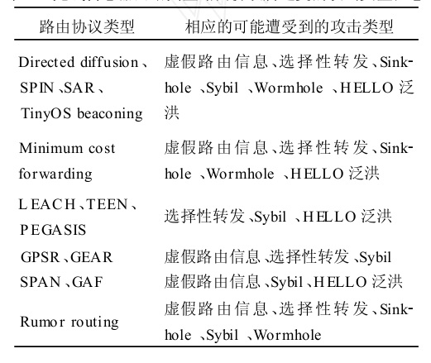
无线传感器网络典型路由协议所遭受的攻击类型汇总

Slide 28
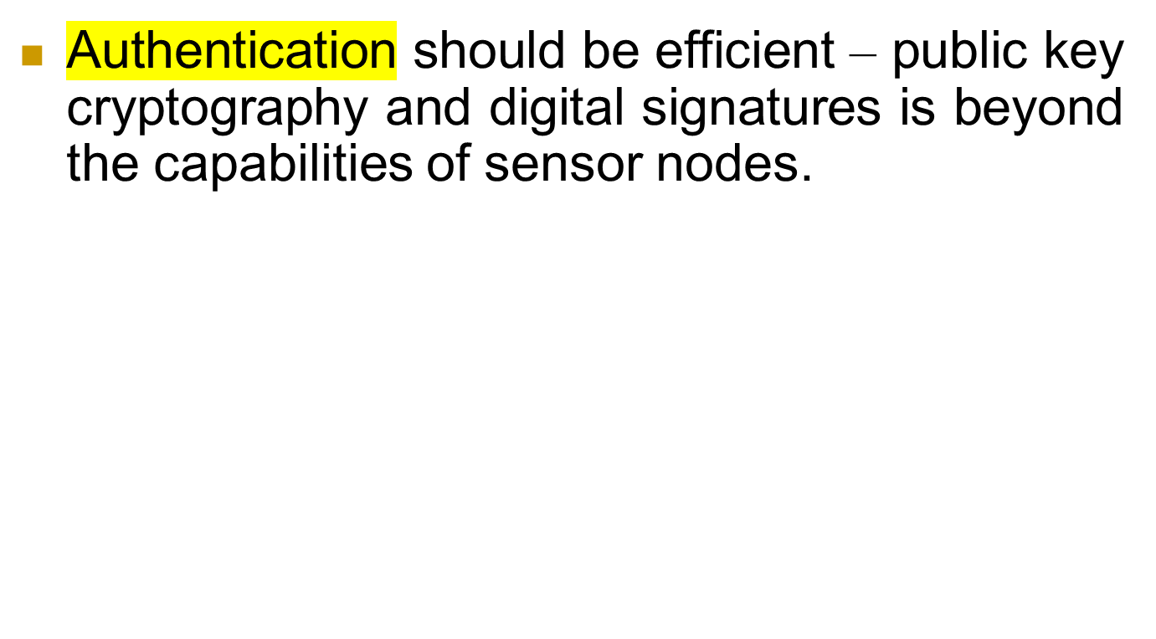
Countermeasures

